Slide 1
Object Oriented Programming
Inheritance

Slide 2
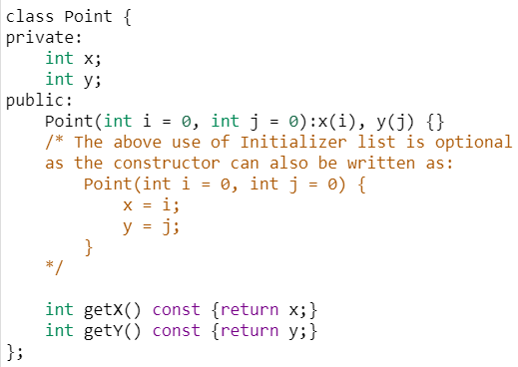
Initializer list
Initializer list is used to initialize data member(s) of the class
The list of members to be initialized is indicated with constructor as a comma-separated list followed by a colon
But there are situations where initialization of data members inside constructor doesn’t work and Initializer list must be used.

Slide 3
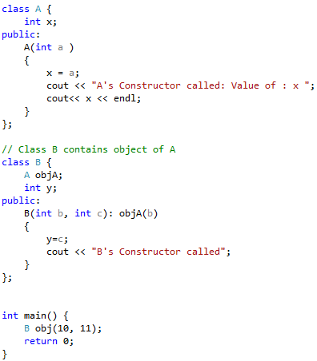
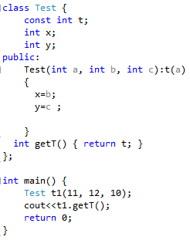
Uses of initializer list
For initialization of non-static const data members
For initialization of member objects which do not have default constructor

Slide 4
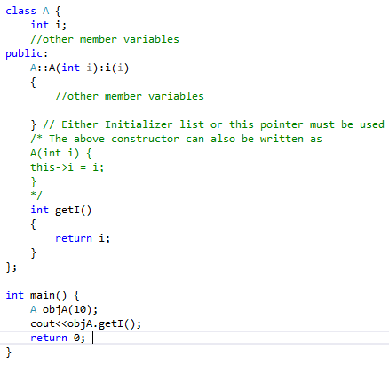
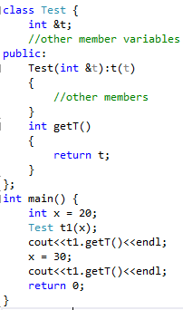
Uses of initializer list (continued)
For initialization of reference members
When constructor’s parameter name is same as data member

Slide 5
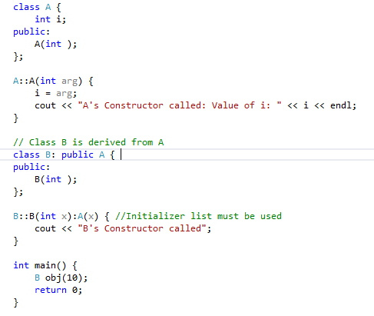
Uses of initializer list (continued)
For initialization of base class members
Parameterized constructor of the base class can only be called using Initializer List

Slide 6
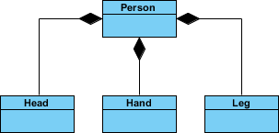
Inheritance and Composition
The common ways to relate two classes in a meaningful way are:
Inheritance (“is-a” relationship)
Composition / Aggregation (“has-a” relationship)
Organization
Employee

Slide 7
Inheritance
Person
Inheritance is an “is-a” relationship
Example: “every employee is a person”
Person’s attributes: First Name, Last Name and CNIC No.
Employee’s attributes: First Name, Last Name, CNIC No., Employee ID, Salary, Joining Date etc.
Inheritance lets us create new classes from existing classes
New classes are called the derived classes/child classes
Existing classes are called the base classes / parent classes
Derived classes inherit the properties of the base classes
Employee

Slide 8
Examples
Base class
Student
Shape
Employee
Derived classes
Graduate Student
Undergraduate student
Circle
Rectangle
Faculty Member
Staff member

Slide 9
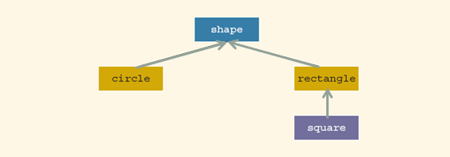
Inheritance (continued)
Inheritance can be viewed as a tree-like, or hierarchical, structure wherein a base class is shown with its derived classes

Slide 10
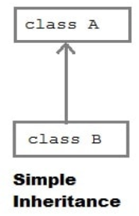
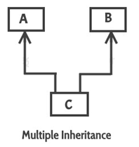
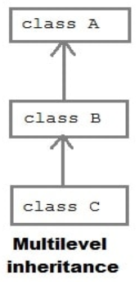
Inheritance (continued)
Single inheritance: derived class has a single base class
Ex. Circle class from Shape class
Mutlilevel Inheritance: where one can inherit from a derived class, thereby making this derived class the base class for the new class.
Ex. Son->Father->Grand Father
Multiple inheritance: derived class has more than one base class
Ex. Son class from Mother class and Father class

Slide 11
Defining a simple subclass (1)
We can use each class as a base (or a foundation) to define or build another class (a subclass). It’s also possible to use more than one class to define a subclass. You can see both of these cases given below.
Note that the arrows always point to the superclass(es).
The left diagram illustrates a “single inheritance”, and the right one a “multiple inheritance” or “multi-inheritance”.
We can also write about super classes as base classes, and subclasses as derived classes.

Slide 12
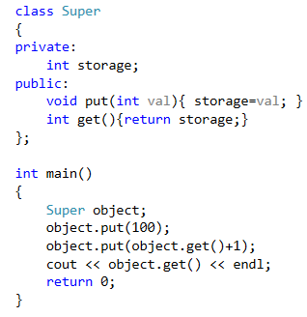
Defining a simple subclass (2)
The class on the right → will serve as a superclass. Analyze its structure – it’s not difficult, we promise.
The program emits the following text:
101

Slide 13
Inheritance (continued)
General syntax of a derived class:
Where memberAccessSpecifier is public, protected, or private (default)
The private members of a base class are inaccessible in the derived class
Derived class cannot directly access them
Ex. Class SonClass: public FatherClass
{
};

Slide 14
Defining a simple subclass (3)
If we want to define a class named Y as a subclass of a superclass named X, we use the following syntax
If there’s more than one superclass, we have to enlist them all using commas as separators, like this:
class A : X, Y, Z
{
member list;
};
Let’s start with the simplest possible case.
class Y : private or public or protected X
{
member list;
};

Slide 15
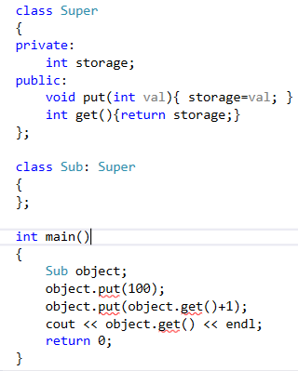
Defining a simple subclass (4)
Take a look here → We’ve defined a class named Sub, which is a subclass of a class named Super. We may also say that the Sub class is derived from the Super class.
The Sub class introduces neither new variables nor new functions. Does this mean that any object of the Subclass inherits all the traits of the Super class, being in fact a copy of the Super class’s objects?
No. It doesn’t.

Slide 16
6.1.4 Defining a simple subclass (4) cont’d
If we compile the following code, we’ll get nothing but compilation errors saying that the put and get methods are inaccessible. Why?
When we omit the visibility specifier, the compiler assumes that we’re going to apply a “private inheritance”. This means that all public superclass components turn into private access, and private superclass components won't be accessible at all. It consequently means that you’re not allowed to use the latter inside the subclass.
This is exactly what we want now.

Slide 17
Defining a simple subclass (4) cont’d
We have to tell the compiler that we want to preserve the previously used access policy. We do this by using a “public” visibility specifier:
class Sub : public Super { };
Don’t be misled: this doesn’t mean that the private components of the Superclass (like the storage variable) will magically turn into public ones. Private components will remain inaccessible, public components will remain public.

Slide 18
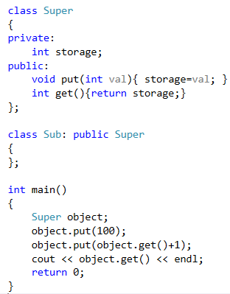
Defining a simple subclass (5)
Objects of the Sub class may do almost the same things as their older siblings created from the Superclass. We use the word ‘almost’ because being a subclass also means that the class has lost access to the private components of the superclass.
We cannot write a member function of the Sub class which would be able to directly manipulate the storage variable.

Slide 19
Defining a simple subclass (5) cont’d
There’s the third access level we haven’t mentioned yet. It’s called “protected”.
The keyword protected means that any component marked with it behaves like a public component when used by any of the subclasses and looks like a private component to the rest of the world.
We should add that this is true only for publicly inherited classes (like the Super class in our example previous example)
Let’s make use of the keyword right now.

Slide 20
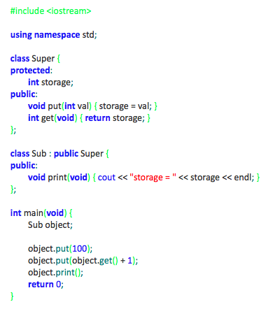
Defining a simple subclass (6)
As you can see in the example code →
we’ve added some new functionality to the Sub class.
We’ve added the print function. It isn’t especially sophisticated, but it does one important thing: it accesses the storage variable from the Superclass. This wouldn’t be possible if the variable was declared as private.
In the main function scope, the variable remains hidden anyway. You mustn’t write anything like this:
object.storage = 0;
The compiler will be very stubborn about this.
We almost forgot to mention that our new program will produce the following output:
storage = 101

Slide 21
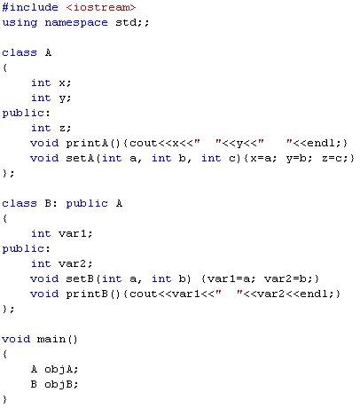
Base
derived

Slide 22
Can not access x, y

Slide 23
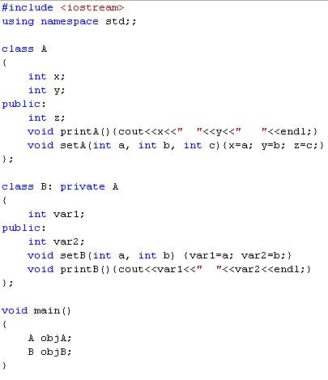

Slide 24
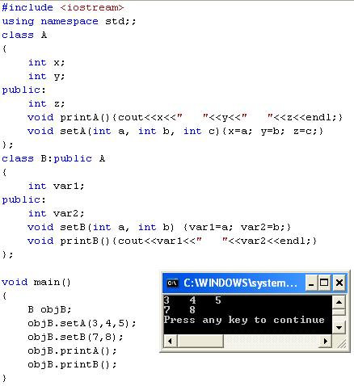

Slide 25
Defining a simple subclass (7)
Now’s a good opportunity to do a little summarizing here. We know that any component of the class may be declared as:
public
private
protected
These three keywords may also be used in a completely different context to specify the visibility inheritance model. So far, we’ve talked about public and private keywords used in such a case. It should be no surprise to you that the protected keyword can be employed in this role, too.

Slide 26
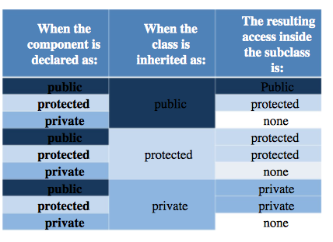
Accessibility
Accessibility:
Private < Protected < Public

Slide 27
Inheritance (continued)
public members of base class can be inherited as public or private members
The derived class can include additional members--data and/or functions
The derived class can redefine the public member functions of the base class
All members of the base class are also member variables of the derived class

Slide 28
End of the Lecture

